Slide 1
Project U.S.A
Class CH Research Project

Slide 2
Introduction
Today, you will be doing a very important task ready for our open afternoon with your parents!
You will need to:
Work as a team!
Work very hard!
Take extra care not to damage the map! No shoes on near the map – map scribes take them off!

Slide 3
The Task
On the floor, you can see a giant map of the U.S.A. There are 50 states on the map; your job… to fill this map with information about every individual state! But not just any information, I want you to, as a minimum, include the following information for EACH state:

Slide 4
Success Criteria for EVERY state
The population of the state
Biggest City
Biggest City population
What is the state most famous for?
Heritage (Where do most people who live there originally come from / Who were the first settlers?)
Any interesting facts
Rivers – Mississippi, National Parks (Yosemite)
Does the state have a flag? If so, I want a picture.
Any other information you can find about the state.

Slide 5
Roles
Scribes (People who write neatly on the map)
Researchers (People who find the information)
Researcher Scribes (People who write the research notes and pass to the scribes)
Researchers and Researcher scribes should swap every 15 minutes.
Image finders – Find pictures about cities, famous landmarks, national parks, famous rivers / waterfalls (You will need to clear with teacher before printing anything!)

Slide 6
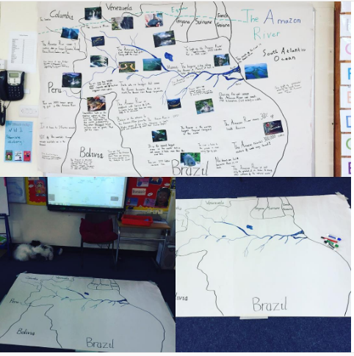
Here is an example of a similar project on ‘The Amazon River’ with a year 4 class from last year:

