Slide 1
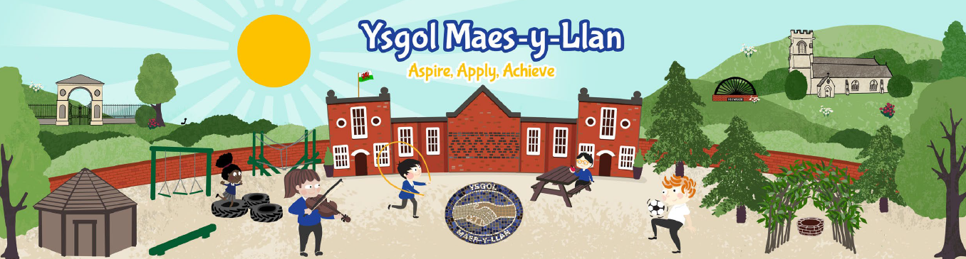
Cynllun Datblygu Ysgol
School Development Plan
Evaluation and Actions Summary
September 2026
Ysgol Maes y Llan, Wrexham

Slide 2


School Development Plan Evaluation-2025/2026
Priority 1: To raise standards in Welsh Oracy skills throughout the school
Created a plan of improvement
Undertaken an audit of the use of Bob Dydd as a baseline
Learning Walk taken place to monitor the use of Welsh within the classrooms
Staff meeting planned to look at how we plan Welsh, to ensure progress.
Continued to use the Tocyn Iaith to promote the use of Welsh with children and staff.
Teaching staff have completed training linked to their phase group.
To continue to develop Criw Cymraeg with planned meetings with SLT on how to continue to develop Welsh Oracy throughout the school and beyond.
Criw Cymraeg to take aspects/whole school assemblies.
To develop phase 3 language immersion phrases.
To review Helpwr Heddiw
This Photo by Unknown Author is licensed under CC BY-NC

Slide 3
School Development Plan Evaluation-2025/2026
Priority 2: Plan opportunities for pupils to develop their digital skills progressively and to apply their digital skills across the curriculum.
Our Digital Lead has conducted a survey of staff confidence and training needs.
Formed a Digital Leads group and they have held their first meeting.
Staff training in the use of AI in the classroom.
Decided to teach DCF as a discreet lesson to ensure the teaching of, and a progression of skills across the curriculum.
Held a parent ICT workshop focusing on online safety, use of Apps in the classroom, sharing examples of ICT work and undertaking an activity on coding.
Reviewed impact
To continue to use Digital Den as support for teachers.
To continue to teach ICT skills discreetly
To monitor and collect examples of work to monitor progress
This Photo by Unknown Author is licensed under CC BY-NC

Slide 4
School Development Plan Evaluation 2025/2026
Priority 3: To strengthen and embed opportunities for pupils to apply and develop their numeracy skills across the curriculum.
Undertaken the Curriculum Design Course to adapt medium term planning to focus on the ‘why’ rather than the ‘what’.
Have begun collecting evidence of examples of numeracy across the curriculum linking to medium term planning.
Began the cluster collaboration project ‘Primed for Success’
Audited Maths resources and created a Maths Area within each class ensuring that the resources are progressive.
Sharing of good practice through visiting a school setting with continuous provision within KS2.
To develop the cluster project ‘Primed for Success’ across the school.
To review the development of mathematical skills across the school
This Photo by Unknown Author is licensed under CC BY-NC

Slide 5
School Development Plan Evaluation-2025/2026
Priority 4: To ensure all pupils are appropriately challenged and provided with meaningful opportunities to develop, apply, and extend their skills independently across the curriculum.
Staff meetings held focussing on progression across the curriculum.
Staff plan for opportunities for pupils to deepen their understanding through independent activities across the AoLEs.
Developing areas of the outside provision.
Curriculum storyboard planning designs training project carried out by BR/JG to be rolled out through CPD to rest of staff, developing medium-term plans that are pupil-led, and with four purposes and integral skills at the heart.
Collation of progressive AfL strategies bank still ongoing, in the formulation of roadmaps.
Completed road-maps/ progressive document for AfL strategies.
To implement the roadmaps in each class to support teachers.
Will review self and peer assessment.
This Photo by Unknown Author is licensed under CC BY-NC

Slide 6
Self Evaluation Summary 2025/2026
Leadership
A clear vision for the school which focuses on wellbeing, teaching and learning.
Self evaluation procedures have led to identifying improvement priorities.
A Governing Body which supports and challenges the school’s direction.
A culture of professional learning to ensure that all staff are developed.
Cluster collaboration is well established with all staff.
Learning and Teaching
Teachers have high expectations of pupils’ behaviour and lessons progress at an appropriate pace.
Most teachers use questioning skilfully to assess progress and extend learning in lessons.
Teachers capture pupil progress effectively.
Teachers collaborate with other schools and wider partners to develop innovative approaches to school improvement
Curriculum
Pupil voice is effective when planning a topic.
Long term planning to ensure coverage of AOLEs.
Wellbeing is central to the school's purpose.
Ongoing assessments are robust and show progression.
Professional dialogue on progress is well established.
Pupils with additional needs, including vulnerable children are supported well through individual plans.
Wellbeing and Inclusion
Most pupils, including vulnerable and pupils with ALN make good progress. They respond positively to the learning experiences.
Nearly all pupils speak confidently about their learning and are developing strategies to take responsibility for their own learning.
During learning walks, nearly all pupils were observed being focused on learning and were happy and proud to share their experiences.
Implementation of the Happy Minds programme, whole school approach to wellbeing.
Strong focus in promoting healthy lifestyles.
Strengths
Development
Leadership collaboration through Cluster projects.
Engage with the wider community to support school improvement.
To continue to develop Welsh Oracy Skills across the school.
To continue to collaborate with cluster schools to develop pedagogy in Maths.
Continue to develop the use of storyboard planning to ensure focus is central to the four purposes and child development.
To further promote opportunities to develop the integral skills.
To review current interventions.
To strengthen pupils understanding of using the environment to regulate their emotions.

Slide 7

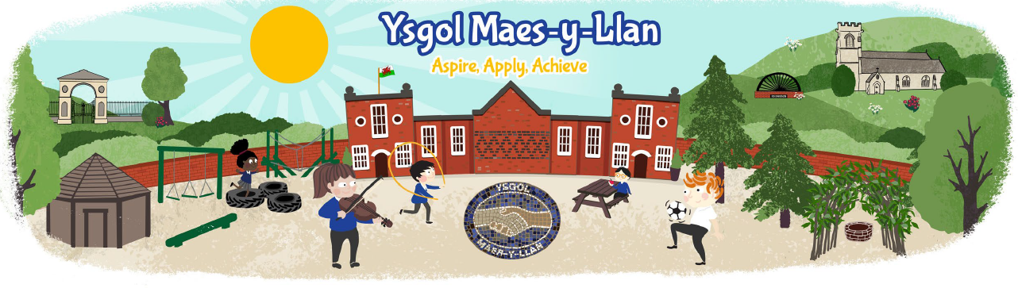
School Development Plan 2026-2027
To raise standards in Oracy skills throughout the school
To further improve Welsh Oracy skills and increase the spontaneous use of Cymraeg across the school
To strengthen Mathematics and Numeracy through progressive and authentic application across the curriculum
Continue to develop reading, including fidelity to the phonics programme
To further develop the Welsh language and culture across the school
Review current curriculum offer and review Assessment for Learning strategies
To develop a coherent and progressive approach to Relationships and Sexuality Education (RSE) and Religion, Values and Ethics (RVE) across the school

